Slide 1

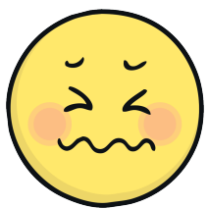
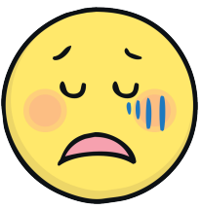

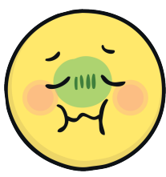

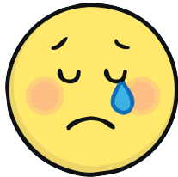
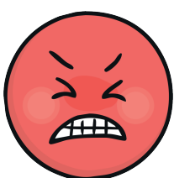

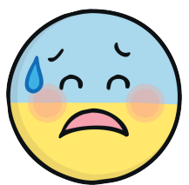
Zones of Regulation at Blackmore Primary School

Slide 2
What is Zones of Regulation?
Have you heard of it?

Slide 3
Can you label these emotions?
Think of a time when you felt one of these emotions…

Slide 4
We all feel different emotions at different times and that is ok
This week we are all going to be getting in the zone…, exploring different emotions and feelings
Zones of Regulation is going to help us to get better at recognising our emotions and knowing what to do about them..

Slide 5
We will be learning about our emotions through four coloured zones..
Blue Zone
Green Zone
Red Zone
Yellow Zone

Slide 6
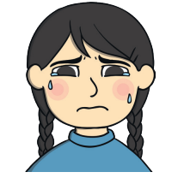
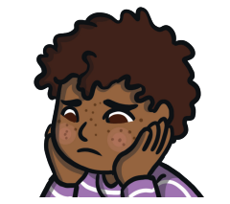
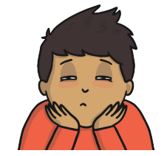
The Blue Zone
The Blue Zone describes the way we feel when our body is feeling low.
We might feel sad, tired, hungry, bored or unwell.
We might feel that our body is running slow when we are in the blue zone…
How does your body feel when you are tired?

Slide 7

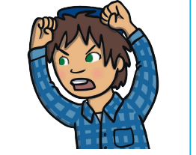
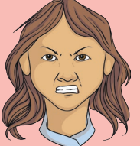
The Red Zone
The Red Zone describes the way we feel when we have very strong and intense emotions.
We might feel angry, panicked or terrified!
We might feel that our body is losing control and we don’t know what to do…
Have you ever felt in the RED zone?

Slide 8
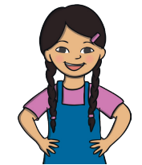
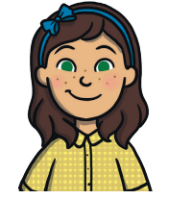
The Green Zone
The Green Zone describes the way we feel when our body is feeling calm and content.
We might feel happy and focused. We can do good listening.
When we are in the green zone, we feel good.
The green zone is ideal for learning.
You can make good decisions and you are able to help others.

Slide 9
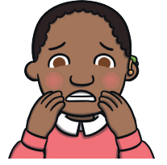
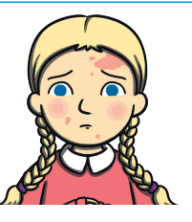

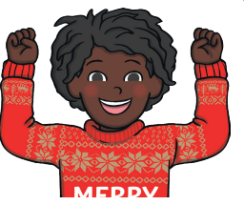
The Yellow Zone
In the Yellow Zone we might feel anxious, worried, scared, nervous or frustrated..
Or we might feel silly, over excitable, shocked or surprised…
Our emotions are strong in the yellow zone, but we are usually able to control them. Our level of alertness is high.
What puts you in the yellow zone?

Slide 10
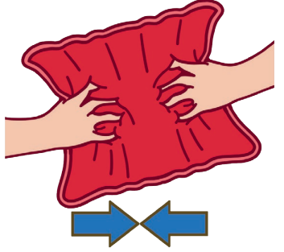
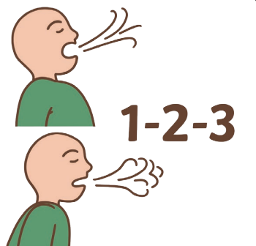
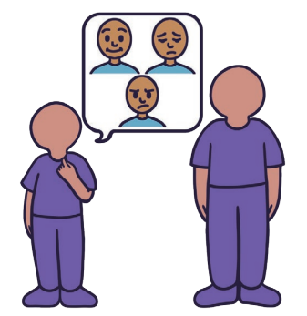
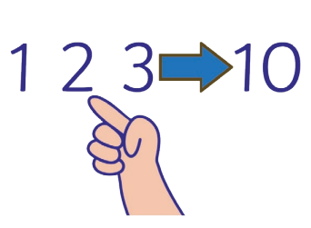

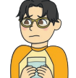



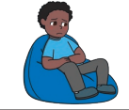
This week at school, every class is going to be learning about each of the coloured zones.
We will be thinking about what strategies and tools we can use to move from zone to zone.
What do you enjoy to do to help you feel calm?

Slide 11
Have you heard of SELF-REGULATION?
Self-regulation is being able to manage our emotions and feelings.
It helps us to complete our day to day tasks better, such as learning and play.
We feel more confident when we can self-regulate. We are more in control of what we are doing and what we need to do next.
Whilst learning about our emotions and our feelings, we are also learning about how to help ourselves to feel better.

Slide 12
Quick Quiz
What colour zone would you put this emotion in?

Slide 13
Quick Quiz
What colour zone would you put this emotion in?

Slide 14
Quick Quiz
What colour zone would you put this emotion in?

Slide 15
Quick Quiz
What colour zone would you put this emotion in?

Slide 16
Lets have a great week of learning and getting in the Zone!
To end our week on Friday we will be having a ZONES NON UNIFORM DAY and celebrating our learning in sharing assembly!

